Slide 1
Prefix Computation & List Ranking Algorithms

Slide 2
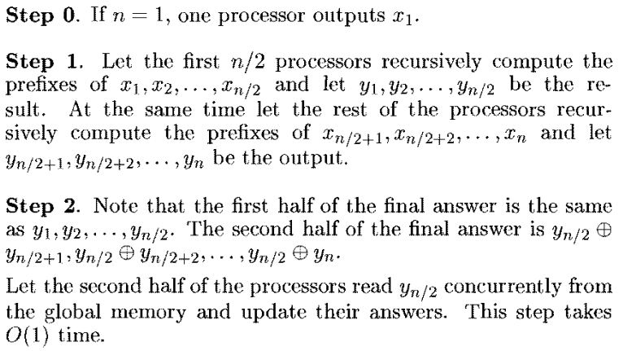
Prefix computation in O(log n) time

Slide 3
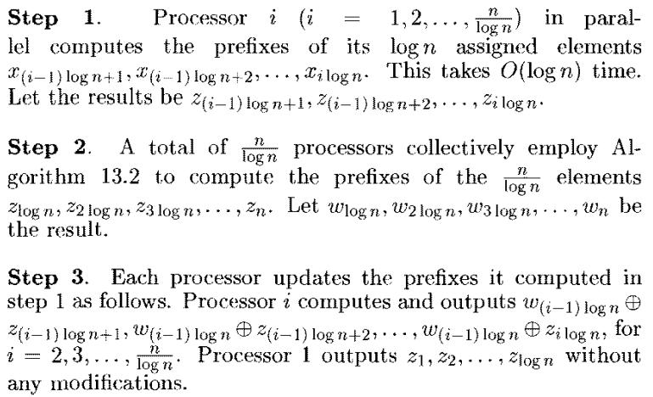
Work-optimal logarithmic time prefix computation

Slide 4
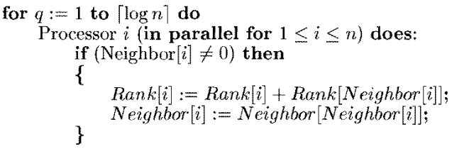
An O(n log n) work list ranking algorithm

Slide 5
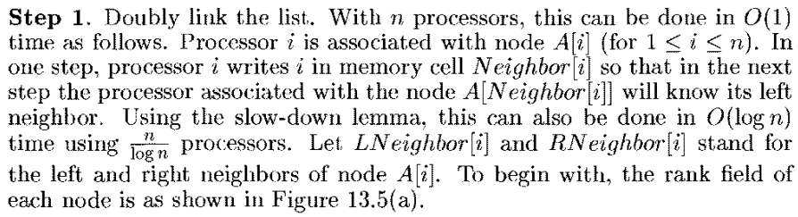
Splicing out nodes

Slide 6
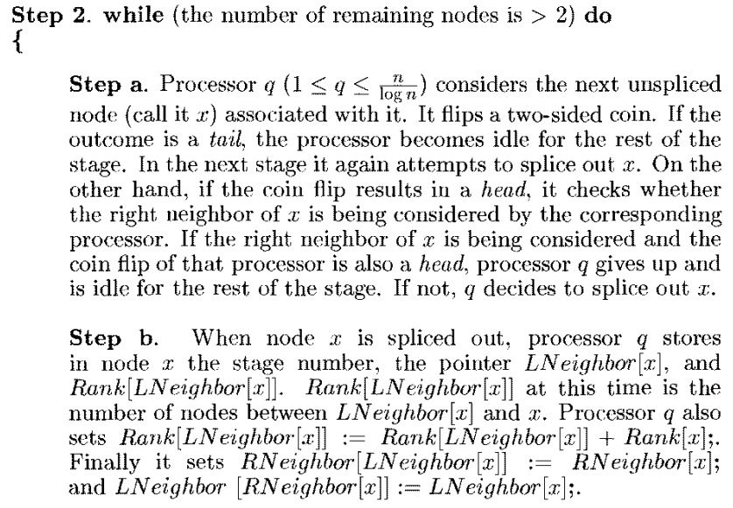

Slide 7
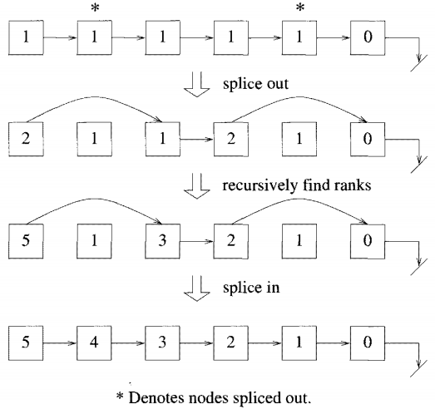
Example: Splicing in and splicing out nodes. (Only right links of nodes are shown)

